Slide 1
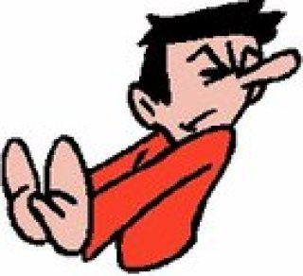
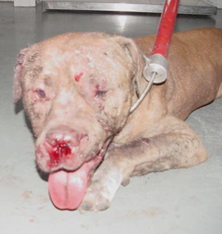
Abominate
(verb) to have an intense dislike or hatred for.
Synonyms: loathe, abhor, despise, detest
Antonyms: relish, savor, cherish, esteem

Slide 2
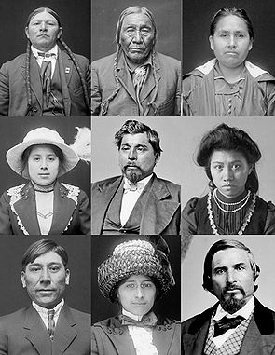
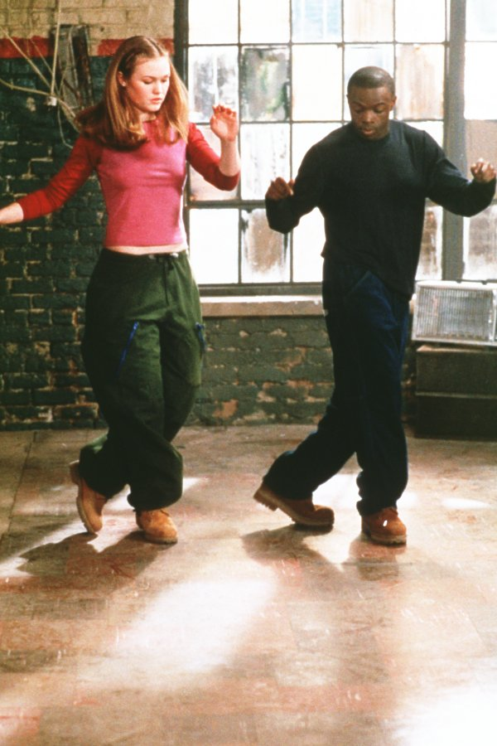
Acculturation
(noun) the modification of the social patterns, traits, or structures of one group or society by contact with those of another; the resultant blend
Synonym: adaptation

Slide 3
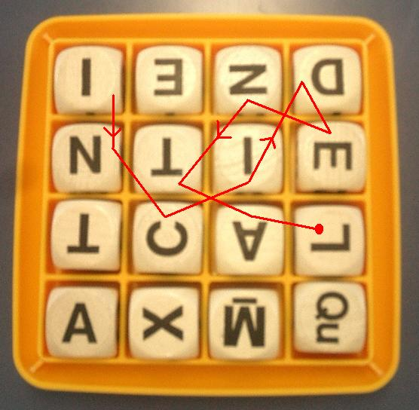
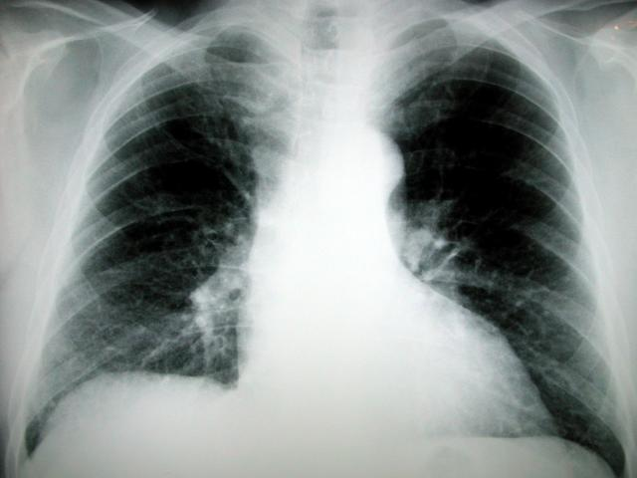
Adventitious
(adjective) resulting from chance rather than from an inherent cause or character; accidental, not essential (medicine) acquired, not congenital
Synonyms: extrinsic, incidental, fortuitous
Antonyms: essential, intrinsic, inherent, congenital

Slide 4
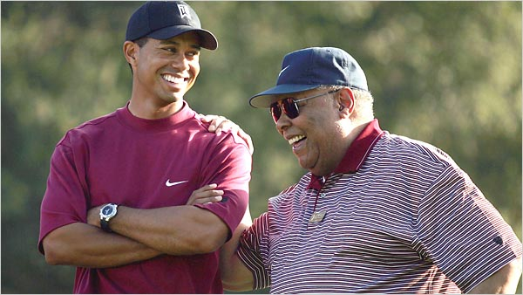
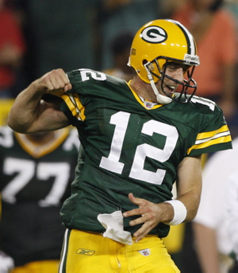
Ascribe
(verb) to assign or refer to (as a cause or source), attribute
Synonyms: impute, credit, attribute

Slide 5
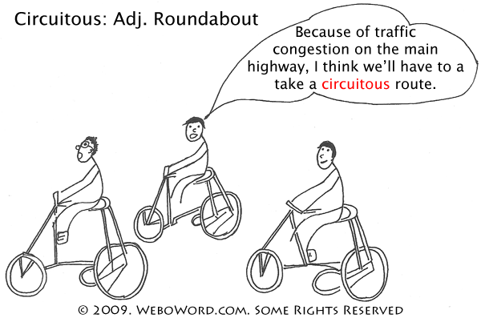
Circuitous
(adjective) roundabout, not direct
Synonyms: indirect, meandering, winding
Antonyms: straight, direct, as the crow flies

Slide 6
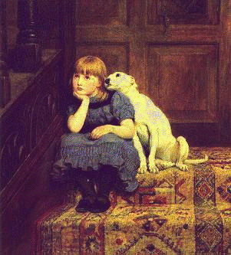
Commiserate
(verb) to sympathize with, have pity or sorrow for, share a feeling of distress
Synonyms: feel sorry for, empathize
Antonyms: feel no sympathy for

Slide 7
Enjoin
(verb) to direct or order; to prescribe a course of action in an authoritative way; to prohibit
Synonyms: bid, charge, command, adjure
Antonyms: allow, permit

Slide 8
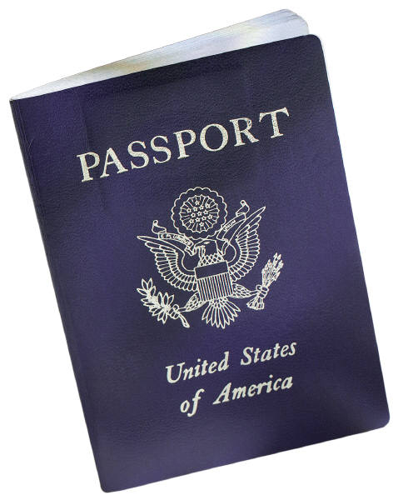
Expedite
(verb) to make easy, cause to progress faster
Synonyms: accelerate, facilitate, speed up
Antonyms: hinder, hamper, impede, obstruct

Slide 9
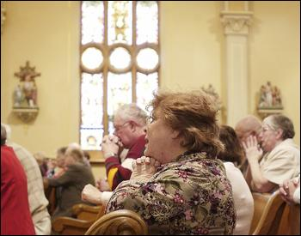
Expiate
Hug it out!
(verb) to make amends, make up for; to avert
Synonyms: redeem, make amends for, atone, make reparation

Slide 10
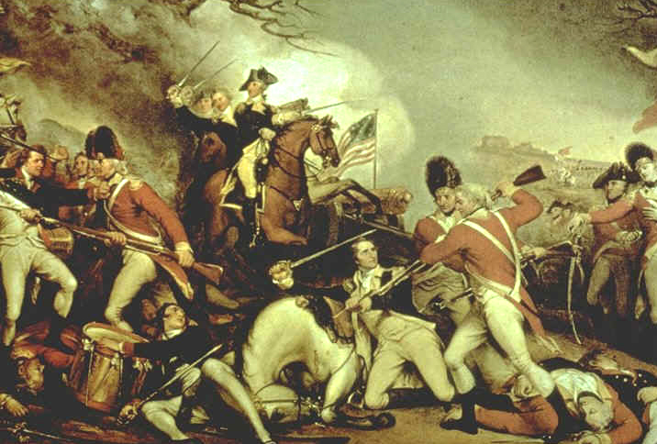
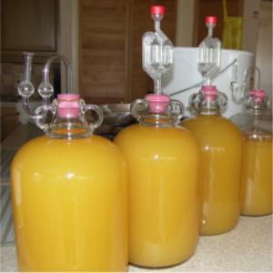
Ferment
(noun) a state of great excitement, agitation, or turbulence; (verb) to be in or work into such a state; to produce alcohol by chemical action
Synonyms: commotion, turmoil, unrest
Antonyms: peace and quiet, tranquility, placidity

Slide 11
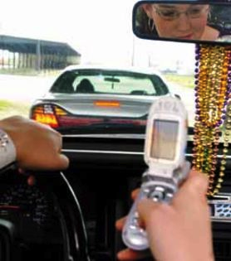
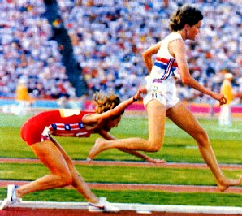
Inadvertent
(adjective) resulting from or marked by lack of attention; unintentional, accidental
Synonyms: accidental, unconsidered
Antonyms: deliberate, intentional, premeditated

Slide 12
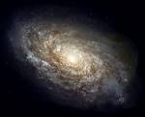
Nominal
(adjective) existing in name only, not real; too small to be considered or taken seriously
Synonyms: titular, token, trifling, inconsequential
Antonyms: real, actual, exorbitant, excessive

Slide 13
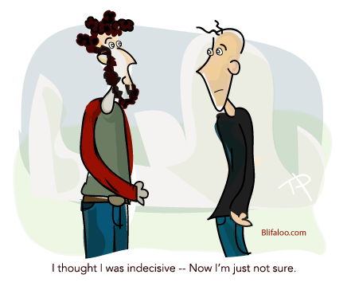
Noncommittal
(Adjective) not decisive or definite; unwilling to take a clear position or to say yes or no
Synonyms: cagey, uninformative, playing it safe, playing it close to the vest
Antonyms: positive, definite, committed

Slide 14
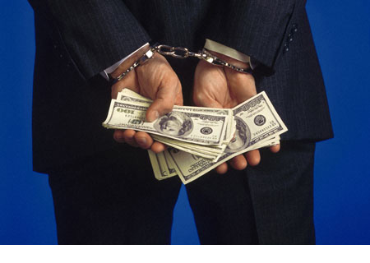
Peculate
(verb) to steal something that has been given into one’s trust; to take improperly for one’s own use
Synonyms: embezzle, defraud, misappropriate

Slide 15
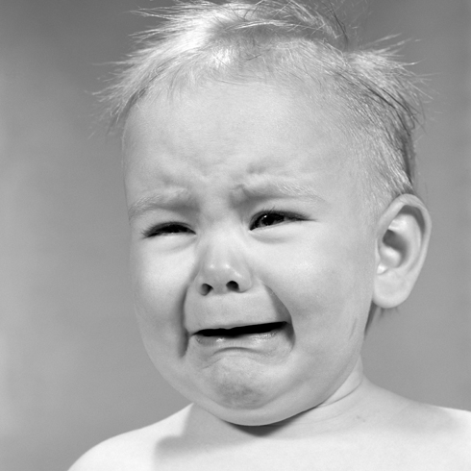
Proclivity
(noun) a natural or habitual inclination or tendency (especially of human character or behavior)
Synonyms: natural bent, penchant, propensity
Antonyms: inability or incapacity

Slide 16
Sangfroid
(noun) composure or coolness, especially in trying circumstances
Synonyms: poise, self-assurance, equanimity
Antonyms: excitability, hysteria, flappability

Slide 17
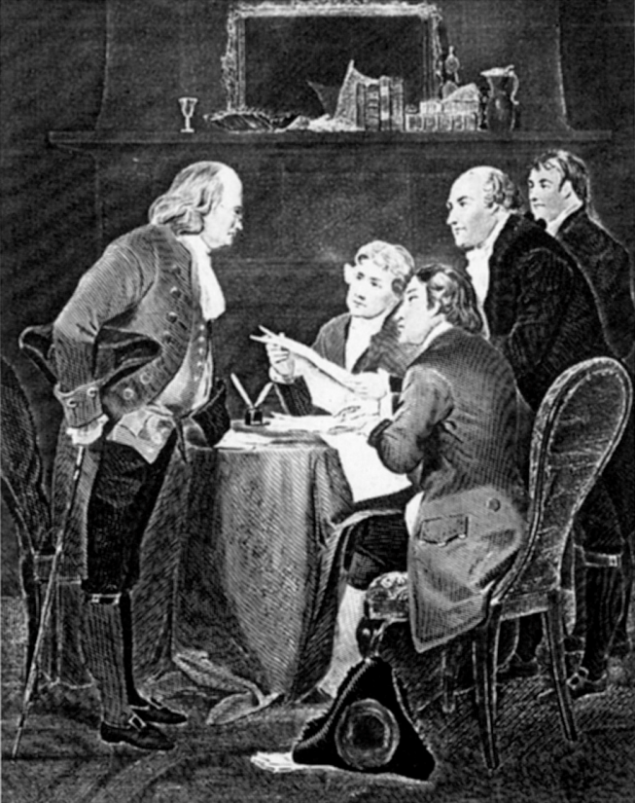
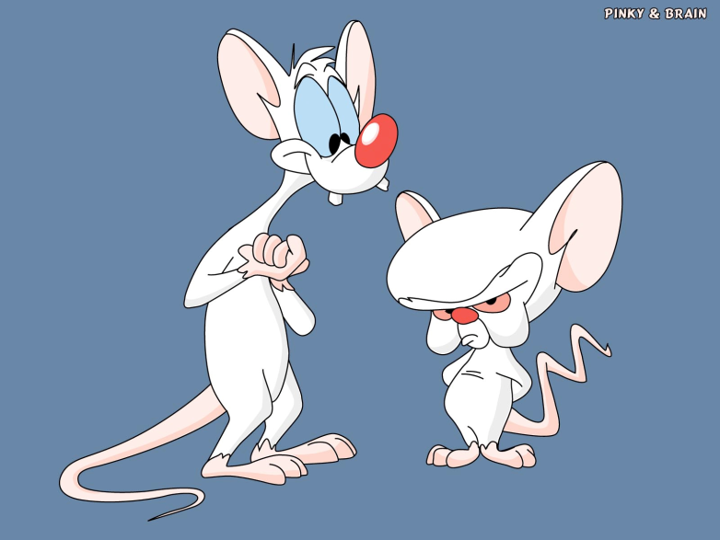
Seditious
(adjective) resistant to lawful authority; having the purpose of overthrowing an established government.
Synonyms: mutinous, rebellious, subversive
Antonyms: supportive, loyal, faithful, allegiant

Slide 18
Tenuous
(adjective) thin, slender, not dense; lacking clarity or sharpness; of slight importance or significance; lacking a sound basis, poorly supported
Synonyms: flimsy, insubstantial, vague, hazy
Antonyms: strong, solid, substantial, valid

Slide 19
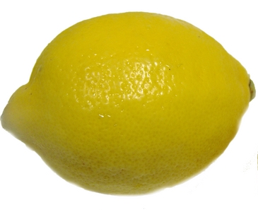
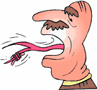
vitriolic
(Adjective) bitter, sarcastic; highly caustic or biting (like a strong acid)
Synonyms: withering, acerbic, mordant
Antonyms: bland, saccharine, honeyed, sugary

Slide 20
Wheedle
(verb) to use coaxing or flattery to gain some desired end
Synonyms: cajole, inveigle, soft-soap, sweet-talk
Antonyms: coerce, browbeat, intimidate, strong-arm

